Slide 1
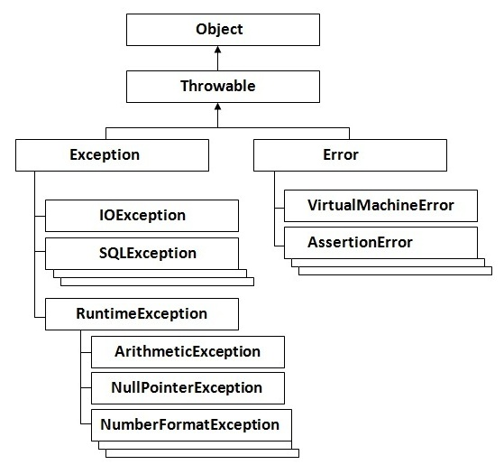
Exception Handling
The exception handling in java is a mechanism to handle the runtime errors so that normal flow of the application can be maintained.
Hierarchy of Java Exception classes :

Slide 2
Types Of Exception:
Checked Exception : The classes that extend Throwable class except RuntimeException and Error are known as checked exceptions e.g.IOException, SQLException etc. Checked exceptions are checked at compile-time.
Unchecked Exception : The classes that extend RuntimeException are known as unchecked exceptions e.g. ArithmeticException, NullPointerException, ArrayIndexOutOfBoundsException etc. Unchecked exceptions are not checked at compile-time rather they are checked at runtime.
Error : Error is irrecoverable e.g. OutOfMemoryError, VirtualMachineError, AssertionError etc.
There are 5 keywords used in java exception handling.
    try
    catch
    finally
    throw
    throws

Slide 3
public class ExcepTest
{
public static void main(String args[])
{
int a[] = new int[2];
try{
System.out.println("Access element three :" + a[3]);
}catch(ArrayIndexOutOfBoundsException e){
System.out.println("Exception thrown :" + e);
}
finally{
a[0] = 6;
System.out.println("First element value: " +a[0]);
System.out.println("The finally statement is executed");
}
}
}

Slide 4
import java.io.*;
public class className
{
public void deposit(double amount) throws RemoteException
{
throw new RemoteException();
}
}
import java.io.*;
public class className
{
public void withdraw(double amount) throws RemoteException, InsufficientFundsException
{
// Method implementation
}
//Remainder of class definition }

